Slide 1
Team F Presentation:
Diet Manager Version 1.0
By Daniel Cox
Chad Cummings
Tenzin Dhondup
Chandler Michel
Zhimin Lin

Slide 2
Design Overview
The Diet Manager design incorporates the Composite design pattern and the Model-View-Controller (MVC) architectural pattern. A preliminary design did not incorporate the MVC architectural pattern, but it was later added in order to produce a more extensible application. The Composite pattern is used in order to create a cohesive relationship between the Recipe and BasicFood objects. This section will be updated as we continue to move through the design process.

Slide 3
Function
Add food, recipe to food collection
Delete food, recipe from food collection
Record food, recipe in food CSV
Add weight, food intake, desired calorie limit to daily log (Log CSV)
Delete weight, food intake, desired calorie limit from daily log (Log CSV)
View food collection/daily Log
Change the daily calorie limit and weight for the selected date

Slide 4
Diet Manager Version 1.0 Demo

Slide 5
Phase 2 Plans

Slide 6
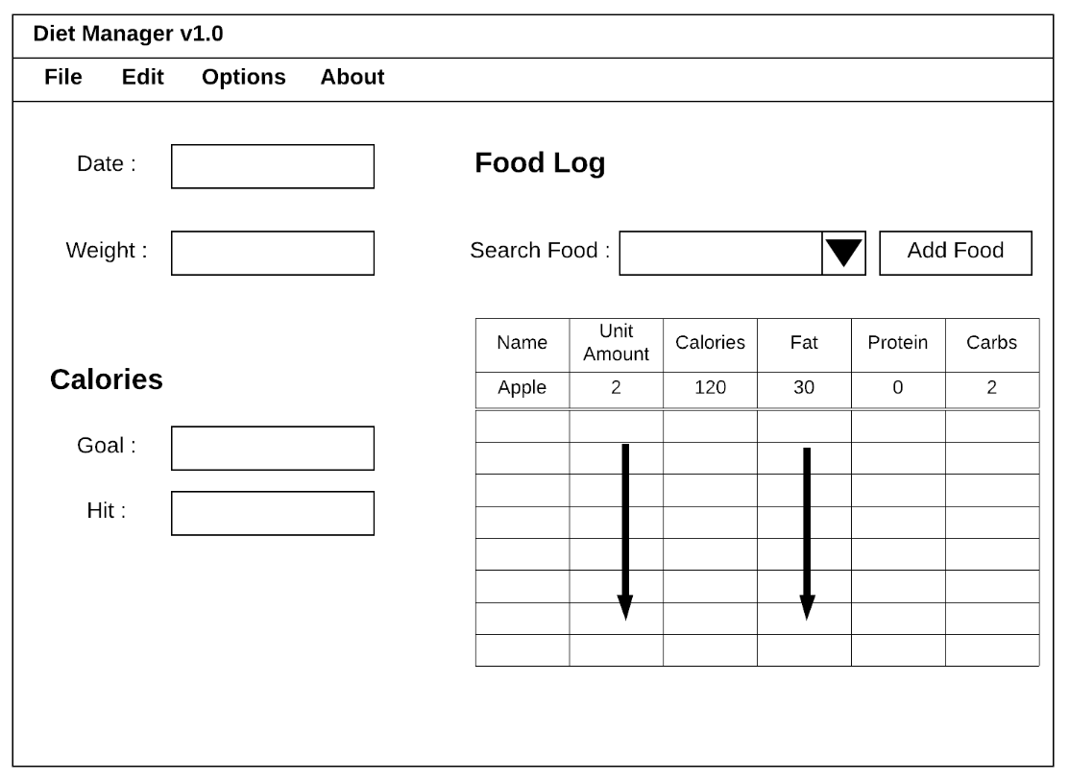
Phase 2 GUI

